Slide 1

Unit 2 - Intersectionality

Slide 2
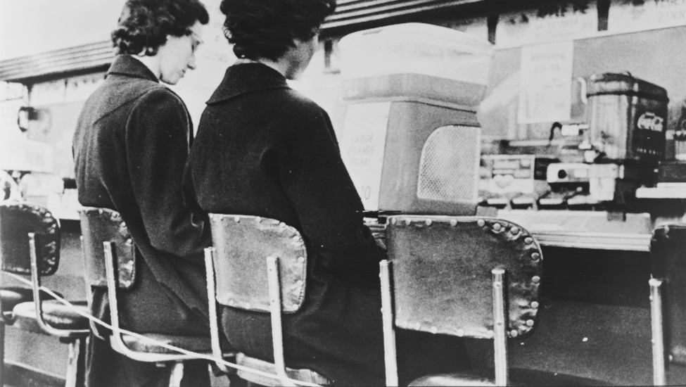
“Take notice, inhabit and observe the workings of ordinariness”
Kathleen Stewart, Ordinary Affects, 2007

Slide 3

Race to the Bus – Directed by Isadora Knutsen
SUN SONG - Directed by Joel Wanek
(https://mubi.com/en/films/117853/player)
Notes:
What did you see, feel, understand from these films? What do they tell us about intersectionality?

Slide 4
Intersectionality
What is your defintion?
How do you understand it?

Slide 5
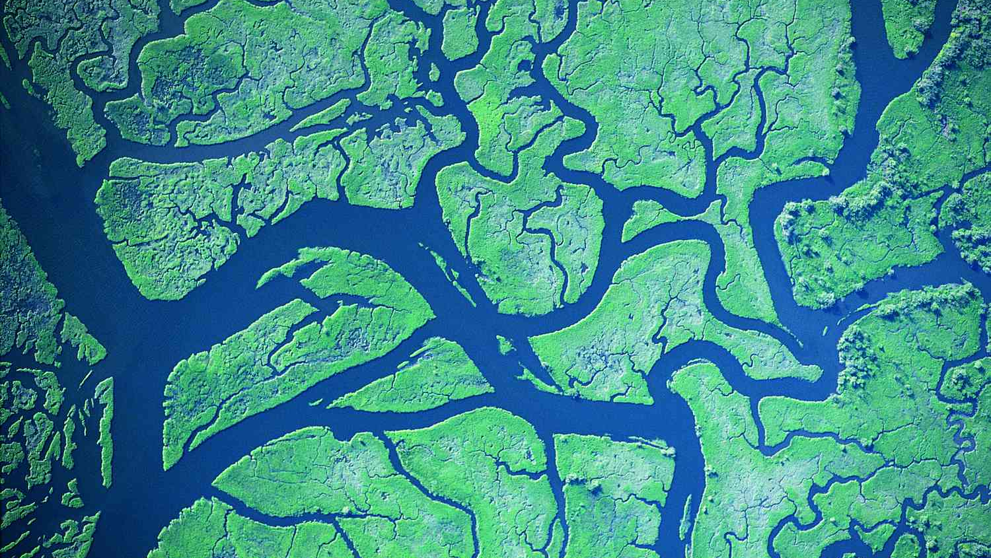
“Intersections can exist neutrally, whereas domination cannot.”
Hill Collins, 2000

Slide 6
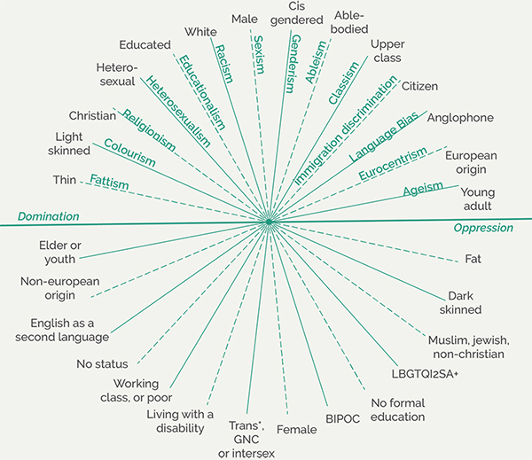
Intersectionality

Slide 7
I treat the word „Black“ in front of „feminism“ not as a marker of identity but as a political category, and I understand a „Black feminist“ approach to be one that centers analyses of racialized sexisms and homophobia, and that foregrounds black women as intellectual producers, as creative agents, as political subjects, and as „freedom dreamers“ even as the content and contours of those dreams vary.
I advance a conception of Black feminism that is expansive, welcoming anyone with an investment in black women’s humanity, intellectual labor, and political visionary work, anyone with an investment in theorizing black genders and sexualities in complex and nuanced ways. Jennifer C. Nash

Slide 8
Intersectionality is a way if understanding and analyzing the complexity in the world, in people, and in human experiences. The events and conditions of social and political life and the self can seldom be understood as shaped by one factor. They are generally shaped by many factors in diverse and mutually influencing ways.
Intersectionality as an analytic tool examines how power relations are intertwined and mutually constructing, race, class, gender, sexuality, di/sability, ethnicity, nation, religion, and age are categories of analysis, terms that reference important social divisions. But they are also categories that gain meaning from power relations of racism, sexism, heterosexism, and class exploitation.
Hill Collins, 2016

Slide 9
the claim that intersectionality is inapplicable to other social categories is theoretically unnecessary, descriptively inaccurate, and easily falsifiable. Scholars have mobilized intersectionality to engage multiple axes of difference—class, sexual orientation, nation, citizenship, immigration status, disability, and religion (not just race and gender).
the theory can be used to analyze a range of complex social processes—classism, homophobia, xenophobia, nativism, ageism, ableism, and Islamophobia (not just anti-Black racism and sexism). Seemingly, the genesis of intersectionality in Black feminist theory limits the ability of some scholars both to imagine the potential domains to which intersectionality might travel and to see the theory in places in which it is already doing work .
Intersectionality reflects a commitment neither to subjects nor to identities per se but, rather, to marking and mapping the production and contingency of both.
Devon W. Carbado*

Slide 10
Framing intersectionality as only about women of color gives masculinity, whiteness, and maleness an intersectional pass. That, in turn, leaves colorblind intersectionality and gender-blind intersectionality unnamed and uninterrogated, further naturalizing white male heterosexuality as the normative baseline against which the rest of us are intersectionally differentiated.
Devon W. Carbado*

Slide 11
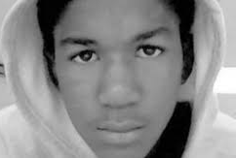
Trayvon Martin
1995 – 2012
Murdered by George Zimmerman.

Slide 12
The Matrix of domination:
The „matrix“ approach emphasizes how racism, sexism, capitalism, and heteronormativity are structurally organized
The labour of the „matrix“ is to describe the specificities of social location and the violence that structures of domination inflict, in various ways and in differing severity, on everyone.
The structural, disciplinary, hegemonic, and interpersonal domains of power shape human action and serve different purposes in maintaining power asymmetries in society. The structural domain covers how the interconnected organization of large-scale social institutions perpetuates systems of oppression.
By exploring how power is constructed along several axes and acts across interrelated domains, the concept surfaces the dialectical relationship between oppression and action.
Hill Collins, 2016

Slide 13


Slide 14
Domains of power
Interpersonal, disciplinary, cultural, and structural.
Notes:
interconnected domains of power:

Slide 15
The disciplinary domain addresses how organizational practices exert power and control over marginalized populations.
The hegemonic domain of power encompasses the exercise of power by dominant groups through “ideology, culture, and consciousness”
the interpersonal domain examines the micro level of social organization and how disempowerment occurs through routine interactions and individual consciousness.

Slide 16
The goal is to “ask the other question”—to explore what else happens, why it happens, and what can be done.

Slide 17
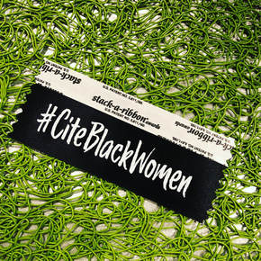
#CiteBlackWomen project
What does it look like to dismantle the patriarchal, white supremacist, heterosexist, imperialist impetus of the neoliberal university (and its accomplices) by centering Black women’s ideas and intellectual contributions?

Slide 18
Who gets to define and produce knowledge matters because people have different ideas of what that scholarship ought to do.

Slide 19
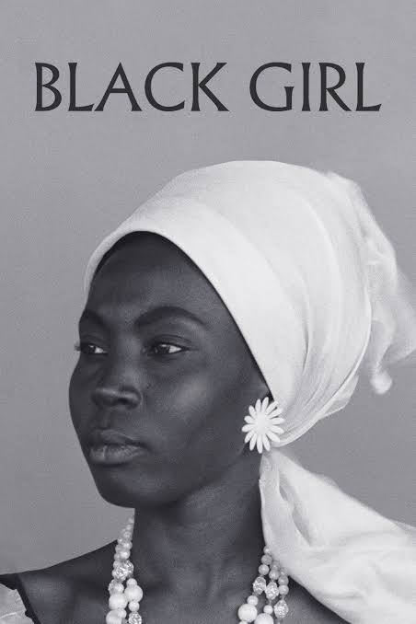
Ousman Sembene – Black Girl (1966)

Slide 20
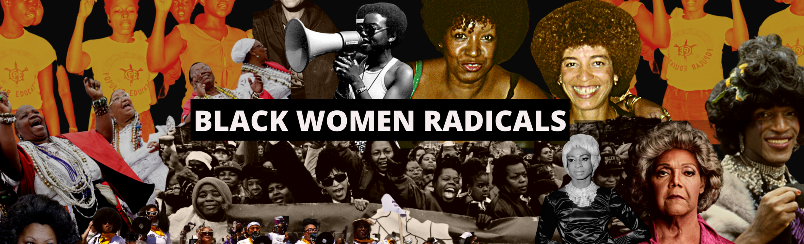
https://blackfeminisms.com/
https://www.blackwomenradicals.com/
https://www.thenapministry.com

